Slide 1
CPT-S 415
Big Data
Yinghui Wu
EME B45

Slide 2
CPT-S 415
Big Data
Graph Query Processing
Basics of Graph Algorithms
  Graph search (traversal)
  PageRank
  Nearest neighbors
  Keyword search
  Graph pattern matching (next lecture)
Notes:
Object.

Slide 3
Graph query processing: operators and algorithms

Slide 4
When it comes to graphs …
Semistructured:
  No schema
  No constraints yet
No standard query languages
  A variety of queries used in practice
  Nontrivial
What is the complexity of the following problems?
  Subgraph isomorphism
  Simple path: given a graph G, a pair (s, t) of nodes in G, and a regular expression R, it is to decide whether there exists a simple path from s to t that satisfies R.
NP-complete
Query optimization techniques, indexing, updates, … preliminary
The study of graph queries is still in its infancy

Slide 5
Basic graph queries and algorithms
Graph search (traversal)
PageRank
Nearest neighbors
Keyword search
Graph pattern matching (a full treatment of itself)
Widely used in graph algorithms

Slide 6
Graph search (traversal)

Slide 7
Path queries
Reachability
  Input: A directed graph G, and a pair of nodes s and t in G
  Question: Does there exist a path from s to t in G?
Distance
  Input: A directed weighted graph G, and a node s in G
  Output: The lengths of shortest paths from s to all nodes in G
Regular path
  Input: A node-labeled directed graph G, a pair of nodes s and t in G, and a regular expression R
  Question: Does there exist a (simple) path p from s to t that satisfies R?

Slide 8
Reachability queries
Reachability
  Input: A directed graph G, and a pair of nodes s and t in G
  Question: Does there exist a path from s to t in G?
Applications: a routine operation
  Social graphs: are two people related for security reasons?
  Biological networks: find genes that are (directly or indirectly influenced by a given molecule
  Nodes: molecules, reactions or physical interactions
  Edges: interactions
How to evaluate reachability queries?

Slide 9
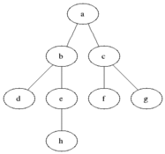
Breadth-first search
Use (a) a queue Que, initialized with s, (b) flag(v) for each node, initially false; and (c) adjacency lists to store G
BFS (G, s, t):
  while Que is nonempty do
    v ← Que.dequeue();
    if v = t then return true;
    for all adjacent edges e = (v, u) of v do
      if not flag(u)
      then flag(u) ← true; enqueue u onto Que;
  return false
Breadth-first, by using a queue
Why do we need the test?
Complexity: each node and edge is examined at most once
What is the complexity?

Slide 10
Breadth-first search
Too costly as a routine operation when G is large
Reachability: NL-complete
BFS (G, s, t): O(|V| + |E|) time and space
  while Que is nonempty do
    v ← Que.dequeue();
    if v = t then return true;
    for all adjacent edges e = (v, u) of v do
      if not flag(u)
      then flag(u) ← true; enqueue u onto Que;
  return false
O(1) time?
Yes, adjacency matrix, but O(|V|²) space
How to trike a balance?

Slide 11
2-hop cover
For each node v in G,
  2hop(v) = (L_{in}(v), L_{out}(v))
  L_{in}(v): a set of nodes in G that can reach v
  L_{out}(v): a set of nodes in G that v can reach
To ensure: node s can reach t if and only if
  L_{out}(s) ∩ L_{in}(t) ≠ ∅
  Testing: better than O(|V| + |E|) on average
  Space: O(|V| |E|^{1/2})
Find a minimum 2-hop cover? NP-hard
Maintenance cost in response to changes to G
A number of algorithms for reachability queries (see reading list)

Slide 12
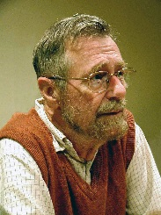
Distance queries
Edsger Wybe Dijkstra
(1930-2002)
Distance: single-source shortest-path problem
  Input: A directed weighted graph G, and a node s in G
  Output: The lengths of shortest paths from s to all nodes in G
Application: transportation networks
Dijkstra (G, s, w):
  for all nodes v in V do
    d[v] ← ∞; ←
  d[s] ← 0; Que ← V;
  while Que is nonempty do
    u ← ExtractMin(Que);
    for all nodes v in adj(u ) do
      if d[v] > d[u] + w(u, v) then d[v] ← d[u] + w(u, v);
Use a priority queue Que; w(u, v): weight of edge (u, v); d(u): the distance from s to u
Extract one with the minimum d(u)

Slide 13
Example: Dijkstra’s algorithm
Example from CLR 2nd ed. p. 528
a
1
b
∞
∞
10
2
3
9
0
4
6
s
5
7
∞
∞
c
2
d
Q = {s,a,b,c,d}
d: {(a,∞), (b,∞), (c,∞), (d,∞)}

Slide 14
Example: Dijkstra’s algorithm
Example from CLR 2nd ed. p. 528
a
1
b
10
∞
10
2
3
9
0
4
6
s
5
7
5
∞
c
2
d
Q = {a,b,c,d}
d: {(a,10), (b,∞), (c,5), (d,∞)}

Slide 15
Example: Dijkstra’s algorithm
Example from CLR 2nd ed. p. 528
a
1
b
8
14
10
2
3
9
0
4
6
s
5
7
5
7
c
2
d
Q = {a,b,d}
d: {(a,8), (b,14), (c,5), (d,7)}

Slide 16
Example: Dijkstra’s algorithm
Example from CLR 2nd ed. p. 528
a
1
b
8
13
10
2
3
9
0
4
6
s
5
7
5
7
c
2
d
Q = {a,b}
d: {(a,8), (b,13), (c,5), (d,7)}

Slide 17
Example: Dijkstra’s algorithm
Example from CLR 2nd ed. p. 528
a
1
b
8
9
10
2
3
9
0
4
6
s
5
7
5
7
c
2
d
Q = {b}
d: {(a,8), (b,9), (c,5), (d,7)}

Slide 18
Example: Dijkstra’s algorithm
Example from CLR 2nd ed. p. 528
a
1
b
8
9
10
2
3
9
0
4
6
s
5
7
Q = {}
d: {(a,8), (b,9), (c,5), (d,7)}
5
7
c
2
d
How to speed it up?
O(|V| log|V| + |E|). A beaten-to-death topic ?

Slide 19
Landmarks
Landmark vectors
  A list of nodes L in a graph G, s.t for each pair (u,v) of nodes in G, there is an node in L on a shortest path from u to v
  Answering distance query: linear time
2
3
…
2
…
4
lm₁
lm₂
…
lmi
…
lmk
4
1
…
1
…
4
A landmark vector LM

Slide 20
Regular path queries
Regular simple path
  Input: A node-labeled directed graph G, a pair of nodes s and t in G, and a regular expression R
  Question: Does there exist a simple path p from s to t such that the labels of adjacent nodes on p form a string in R?
A. Mendelzon, and P. T. Wood. Finding Regular Simple Paths In Graph Databases. SICOMP 24(6), 1995
What is the complexity?
NP-complete, even when R is a fixed regular expression (00)* or 0*10*.
In PTIME when G is a DAG (directed acyclic graph)
Patterns of social links
Why do we care about regular path queries?

Slide 21





Regular path queries
Regular path
  Input: A node-labeled directed graph G, a pair of nodes s and t in G, and a regular expression R
  Question: Does there exist a path p from s to t such that the labels of adjacent nodes on p form a string in R?
strangers-nemeses
What is the complexity?
Biologist
strangers-allies
friends-allies
friends-nemeses
PTIME
Show that the regular path problem is in O(|G| |R|) time
Doctors
Businessman
potential supporters?
fa^{<=2} sa^{<=2}
Alice the journalist
a social voting network
Graph queries are nontrivial, even for path queries

Slide 22
Strongly connected components
A strongly connected component in a direct graph G is a set V of nodes in G such that
  for any pair (u, v) in V, u can reach v and v can reach u; and
  V is maximal: adding any node to V makes it no longer strongly connected
Find social circles: how large? How many?
SCC
  Input: A graph G
  Question: all strongly connected components of G
What is the complexity?
by extending search algorithms, e.g., BFS
O(|V| + |E|)

Slide 23
PageRank

Slide 24
Introduction to PageRank
To measure the “quality” of a Web page
  Input: A directed graph G modelling the Web, in which nodes represent Web pages, and edges indicate hyperlinks
  Output: For each node v in G, P(v): the likelihood that a random walk over G will arrive at v.
Intuition: how a random walk can reach v?
  A random jump: α (1/|V|)
    α: random jump factor (teleportation factor)
  Following a hyperlink: (1 - α) Σ(u ∈ L(v)) P(u)/C(u)
    (1 - α): damping factor
    (1 - α) Σ(u ∈ L(v)) P(u)/C(u): the chances for one to click a hyperlink at a page u and reach v
The chances of hitting v among |V| pages

Slide 25
Intuition
Following a hyperlink: (1 - α) Σ_(u ∈ L(v)) P(u)/C(u)
  L(v): the set of pages that link to v;
  C(u): the out-degree of node u (the number of links on u)
  P(u)/C(u):
    the probability of u being visited itself
    the probability of clicking the link to v among C(u) many links on page u
The chances of reaching page v from page u
Intuition:
    the more pages link to v, and
    the more popular those pages that link to v,
  v has a higher chance to be visited
One of the models

Slide 26
Putting together
The likelihood that page v is visited by a random walk:
  α (1/|V|) + (1 - α) Σ_(u ∈ L(v)) P(u)/C(u)
random jump
following a link from other pages
Recursive computation: for each page v in G,
    compute P(v) by using P(u) for all u ∈ L(v)
  until
    converge: no changes to any P(v)
    after a fixed number of iterations
too expensive; use an error factor
costly: trillions of pages
Parallel computation
How to speed it up?

Slide 27
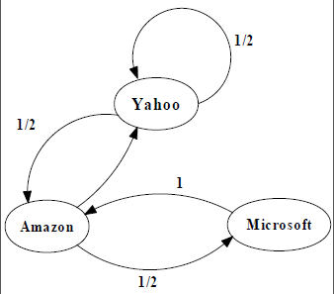
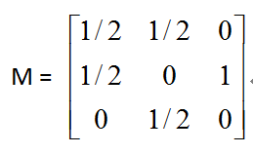
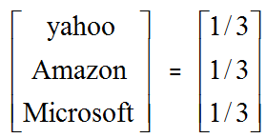
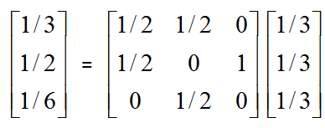
An example of Simplified PageRank
PageRank Calculation: first iteration

Slide 28
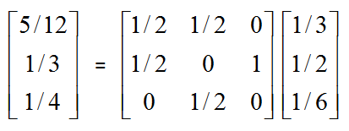
An example of Simplified PageRank
PageRank Calculation: second iteration

Slide 29
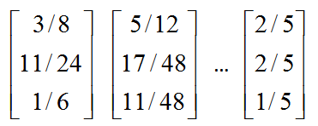
An example of Simplified PageRank
Convergence after some iterations

Slide 30
Nearest neighbors

Slide 31
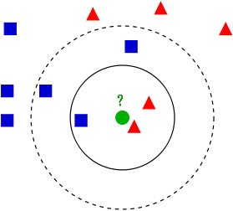
Nearest neighbor
Nearest neighbor (kNN)
  Input: A set S of points in a space M, a query point p in M, a distance function dist(u, v), and a positive integer k
  Output: Find top-k points in S that are closest to p based on dist(p, u)
Euclidean distance, Hamming distance, continuous variables, …
Applications
  POI recommendation: find me top-k restaurants close to where I am
  Classification: classify an object based on its nearest neighbors
  Regression: property value as the average of the values of its k nearest neighbors
Linear search, space partitioning, locality sensitive hashing, compression/clustering based search, …
  A number of techniques

Slide 32
kNN join
kNN join
  Input: Two datasets R and S, a distance function dist(r, s), and a positive integer k
  Output: pairs (r, s) for all r in R, where s is in S, and is one of the k-nearest neighbors of r
Pairwise comparison
A naive algorithm
  Scanning S once for each object in R
  O(|R| |S|): expensive when R or S is large
Can we do better?

Slide 33
Blocking and windowing
blocking
only pairs in the same block are compared
D
B1
partitioning
pairs into blocks
B2
B3
GORDER: An Efficient Method for KNN Join Processing. VLDB 2004.
windowing
window of a fixed size; only pairs in the same window are compared;
D
D
sliding
window
sorting
Several indexing and ordering techniques

Slide 34
Keyword search

Slide 35



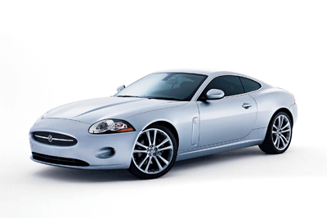


Keyword search
Input: A list Q of keywords, a graph G, a positive integer k
Output: top-k “matches” of Q in G
Information retrieval
Query Q: ‘[Jaguar’, ‘America’, ‘history’]
Jaguar XJ
Black Jaguar
Jaguar XK 001
White Jaguar
Jaguar XK 007
Ford company
history
habitat
offer
habitat
history
offer
Michigan , city
history
North America
New York, city
South America
Michigan
Chicago
result 2
result 4
USA
United States
USA
result 1
result 3
result 5
What makes a match?
How to sort the matches?
How to efficiently find top-k matches?
Questions to answer
Notes:
We start from keyword queries.
as keywords are usually ambiguous, a search process typically generates a large number of answers as small graphs.
let’s consider our knowledge search example. When we pose the query to several knowledge graphs using several
State-of-the-art keyword search engines, we get a long list of answers partly shown here.
The search results we collected from knowledge graphs such as Dbpedia and Yago.
It is obviously daunting if you have to check 100 results one by one trying to find a match that looks like what you want,
And It’s even more frustrating that you end up with nothing and don’t know what to do next.
Clearly, a huge gap is between you and the answers you want.

Slide 36
Semantics: Steiner tree
Input: A list Q of keywords, a graph G, a weight function w(e) on the edges on G, and a positive integer k
Output: top-k Steiner trees that match Q
PageRank scores
Match: a subtree T of G such that
  each keyword in Q is contained in a leaf of T
Ranking:
  The total weight of T (the sum of w(e) for all edges e in T)
The cost to connect the keywords
Complexity?
NP-complete
What can we do about it?

Slide 37
Semantics: distinct-root (tree)
Input: A list Q of keywords, a graph G, and a positive integer k
Output: top-k distinct trees that match Q
Match: a subtree T of G such that
  each keyword in Q is contained in a leaf of T
Ranking:
  dist(r, q): from the root of T to a leaf q
  The sum of distances from the root to all leaves of T
Diversification:
  each match in the top-k answer has a distinct root
O(|Q| (|V| log |V| + |E|))

Slide 38
Semantics: Steiner graphs
Input: A list Q of keywords, an undirected (unweighted) graph G, a positive integer r, and a positive integer k
Output: Find all r-radius Steiner graphs that match Q
Match: a subgraph G’ of G such that it is
  r-radius: the shortest distance between any pair of nodes in G is at most r (at least one pair with the distance); and
  each keyword is contained in either
    a content node: containing the key word
    a Steiner node: on a simple path between a pair of content nodes
Computation: M^{r}, the r-th power of adjacency graph of G
Revision: minimum subgraphs

Slide 39
Answering keyword queries
A host of techniques
  Backward search
  Bidirectional search
  Bi-level indexing
  …
G. Bhalotia, A. Hulgeri, C. Nakhe, S. Chakrabarti, and S. Sudarshan. Keyword searching and browsing in databases using BANKS. ICDE 2002.
V. Kacholia, S. Pandit, S. Chakrabarti, S. Sudarshan, R. Desai, and H. Karambelkar. Bidirectional expansion for keyword search on graph databases. VLDB 2005.
H. He, H. Wang, J. Yang, and P. S. Yu. BLINKS: ranked keyword searches on graphs. SIGMOD 2007.
A well studied topic

Slide 40


However, …
What does the user really want to find? Tree or graph? How to explain matches found?
The semantics is rather “ad hoc”
Query Q: ‘[Jaguar’, ‘America’, ‘history’]
company
history
city
cars
dealer
America
country
Jaguar XJ
Black Jaguar
Jaguar XK 001
White Jaguar
Jaguar XK 007
Ford company
history
habitat
offer
habitat
history
offer
Michigan , city
history
North America
New York, city
South America
Michigan
Chicago
result 2
result 4
USA
United States
USA
result 1
A long way to go
result 3
result 5
Add semantics to keyword search
Notes:
We start from keyword queries.
as keywords are usually ambiguous, a search process typically generates a large number of answers as small graphs.
let’s consider our knowledge search example. When we pose the query to several knowledge graphs using several
State-of-the-art keyword search engines, we get a long list of answers partly shown here.
The search results we collected from knowledge graphs such as Dbpedia and Yago.
It is obviously daunting if you have to check 100 results one by one trying to find a match that looks like what you want,
And It’s even more frustrating that you end up with nothing and don’t know what to do next.
Clearly, a huge gap is between you and the answers you want.

Slide 41
Summing up

Slide 42
Reading List 2: Graph query languages
There have been efforts to develop graph query languages.
Querying topological structures
SoQL: an SQL-like language to retrieve paths
CRPQ: extending conjunctive queries with regular path expressions
  R. Ronen and O. Shmueli. SoQL: A language for querying and creating data in social networks. ICDE, 2009.
  P. Barceló, C. A. Hurtado, L. Libkin, and P. T. Wood. Expressive languages for path queries over graph-structured data. In PODS, 2010
Read this
SPARQL: for RDF data
  http://www.w3.org/TR/rdf-sparql-query/
Unfortunately, no “standard” query language for graphs, yet

Slide 43
Summary and review
Review of searching RDBMS
  Algorithms for selection/complex selection
  Algorithms for joins: what are several common ways to compute joins? Design ideas?
Why are reachability queries? Regular path queries? Connected components? Complexity? Algorithms?
What are factors for PageRank? How does PageRank work?
What are kNN queries? What is a kNN join? Complexity?
What are keyword queries? What is its Steiner tree semantics? Distinct-root semantics? Steiner graph semantics? Complexity?
Name a few applications of graph queries you have learned.
Find graph queries that are not covered in the lecture.

Slide 44
Reading List 2 (graduate students)
G. Bhalotia, A. Hulgeri, C. Nakhe, S. Chakrabarti, and S. Sudarshan. Keyword searching and browsing in databases using BANKS. ICDE 2002.
V. Kacholia, S. Pandit, S. Chakrabarti, S. Sudarshan, R. Desai, and H. Karambelkar. Bidirectional expansion for keyword search on graph databases. VLDB 2005.
H. He, H. Wang, J. Yang, and P. S. Yu. BLINKS: ranked keyword searches on graphs. SIGMOD 2007.
W. Fan, J. Li, S. Ma, N. Tang, and Y. Wu. Adding Regular Expressions to Graph Reachability and Pattern Queries, ICDE 2011.
M. R. Henzinger, T. Henzinger, and P. Kopke. Computing simulations on finite and infinite graphs. FOCS, 1995. http://infoscience.epfl.ch/record/99332/files/HenzingerHK95.pdf
L. P. Cordella, P. Foggia, C. Sansone, M. Vento. A (Sub)Graph Isomorphism Algorithm for Matching Large Graphs, IEEE Trans. Pattern Anal. Mach. Intell. 26, 2004 (search Google scholar)
A. Fard, M. U. Nisar, J. A. Miller, L. Ramaswamy, Distributed and scalable graph pattern matching: models and algorithms. Int. J. Big Data. http://cobweb.cs.uga.edu/~ar/papers/IJBD_final.pdf
W. Fan J. Li, S. Ma, and N. Tang, and Y. Wu. Graph pattern matching: From intractable to polynomial time, VLDB, 2010.
W. Fan, F. Geerts, and F. Neven. Making Queries Tractable on Big Data with Preprocessing, VLDB 2013

